Slide 1
Immune Thrombocytopenia
Disease Awareness Program Slide
Novartis Singapore P3 approval #SG2010199741 Exp. 18-Oct-2022

Slide 2
Disclaimer
“This presentation/slide deck may include data on an indication that has not been approved or cleared for use in Singapore by the Health Sciences Authority. It is intended to provide you with pertinent scientific data to form your own conclusions and make your own decisions. Information in this presentation/slide deck is not intended to be promoting or recommending any indication, dosage or other claim not covered in the licensed product information. Novartis does not support the promotion of its products in a manner inconsistent with its approved labelling.”

Slide 3
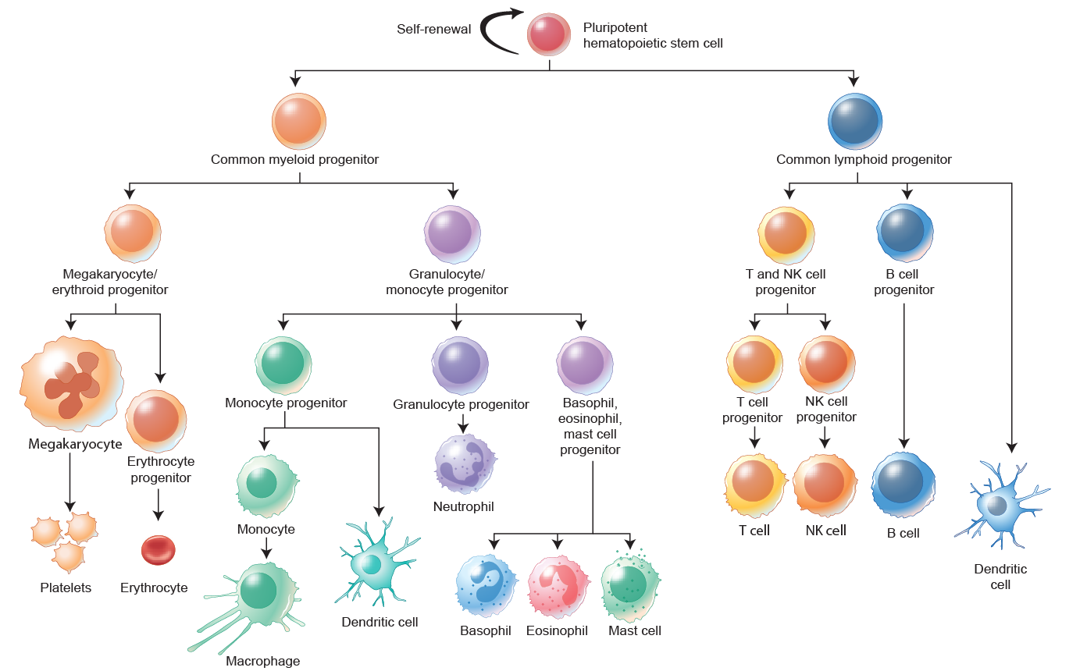
Function of platelet
Platelets
Also called thrombocytes
Platelets are critical for blood clotting to protect against excessive blood loss after injury¹
Platelets adhere to damaged blood vessels, become activated, and release fibrin, forming a net to catch surrounding platelets and red blood cells to form a platelet plug¹
Blood clot
Erythrocyte
Blood vessel
Platelet
Fibrin
1. Angiolillo DJ, et al. Circ J. 2010;74:597-607.

Slide 4
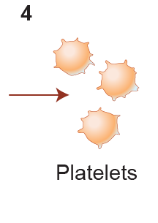
Development of platelet
Megakaryopoiesis and thrombopoiesis
Platelets are primarily produced in the bone marrow¹
They result from the differentiation of hematopoietic stem cells (HSC) into megakaryocyte progenitors, and then megakaryocytes, a process referred to as megakaryopoiesis¹
The process of platelet development is called thrombopoiesis¹:
  Megakaryocytes shed numerous cytoplasmic protrusions called proplatelets into the lumen of blood vessels; proplatelets are sheared by the blood flow and divide into platelets. Thus, platelets are fragments of megakaryocyte
TPO (Thrombopoietin), a hematopoietic growth factor, plays an integral role in megakaryopoiesis and thrombopoiesis by promoting megakaryocyte differentiation and platelet production^{1–3}
TPO stimulates megakaryocyte differentiation and platelet production
TPO
TPO-R
Blood vessel
Common
Myeloid progenitor
Megakaryocyte/
erythroid progenitor
HSC
Megakaryocyte
1. van der Meijden PEJ, Heemskerk JWM. Nat Rev Cardiol. 2019;16:166-79.
2. Kuter DJ, Begley CG. Blood. 2002;100:3457-69.
3. Wolber EM, Jelkman W. News Physiol Sci. 2002;17:6-10.
Platelet
Megakaryocyte protrusion

Slide 5
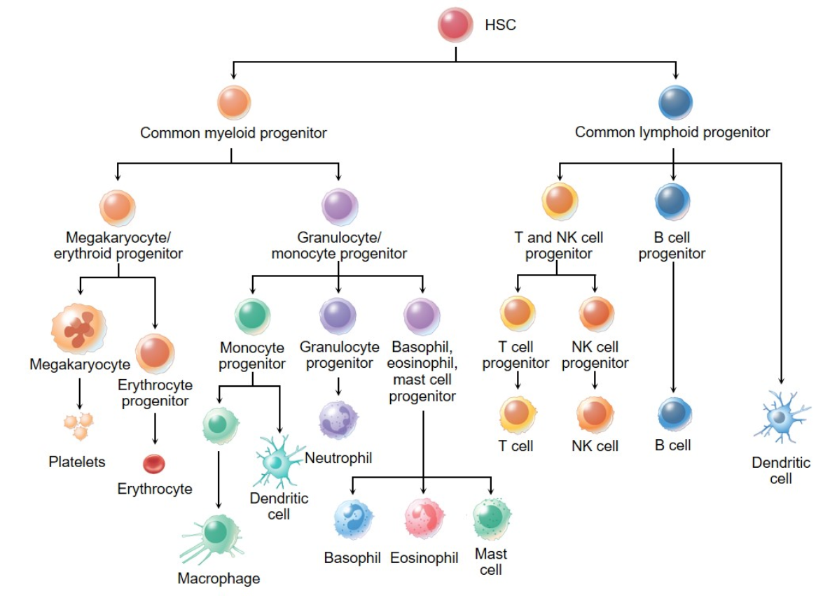
Hematopoiesis lineages

Slide 6
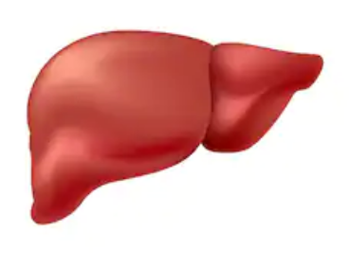
Platelet homeostasis
TPO is produced primarily in the liver^{1–3}
The TPO receptor (TPO-R) is expressed by platelets and megakaryocyte progenitors¹
Blood platelet levels are regulated by TPO and the balance between platelet production and destruction
  Platelets bind, internalize, and destroy TPO. Thus, when platelet levels are low, TPO levels increase¹
  As a result, free TPO becomes available to bind to myeloid progenitors, promoting the development of megakaryocytes and the production of platelets^{1,2}
  The platelets produced destroy TPO and regulate the binding of the hormone to megakaryocyte precursors
  Old platelets are also destroyed in the liver by hepatocytes. They have a lifespan of approximately 10 days. Platelets that are damaged are destroyed in the spleen where they are engulfed by macrophages
Surprisingly, TPO levels usually remain within the normal range in ITP patients
TPO production
Liver
Binding of TPO
to the TPO-R
and internalization
Megakaryocyte
Platelets
Platelet production and TPO degradation
TPO
degradation
1. Mitchell O, et al. Hepat Med. 2016;8:39-50.
2. van der Meijden PEJ. Heemskerk JWM. Nat Rev Cardiol. 2019;16:166-79.
3. Kuter DL, Begley CG. Blood. 2002;100:3457-69.
Adapted from Mitchell O, et al. Hepat Med. 2016;8:39-50.

Slide 7

Key characteristics of immune thrombocytopenia (ITP)
ITP (Immune ThrombocytoPenia) is an autoimmune disease characterized by:^{1,2}
  An immune-mediated destruction of platelets with a transient or persistent platelet count
  < 100 × 10⁹/L
  An increased risk of bleeding due to impaired blood-clotting mechanisms
  The acronym “ITP” should not be confused with the definition of “idiopathic thrombocytopenic purpura” that has been used previously³
    ITP is no longer considered an idiopathic disease and a proportion of patients do not present with purpura
1. Rodeghiero F, et al. Blood. 2009;113:2386-93.
2. Audia S, et al. Autoimmun Rev. 2017;16:620-32.
3. Swinkels M, et al. Front Immunol. 2018;9:880.

Slide 8
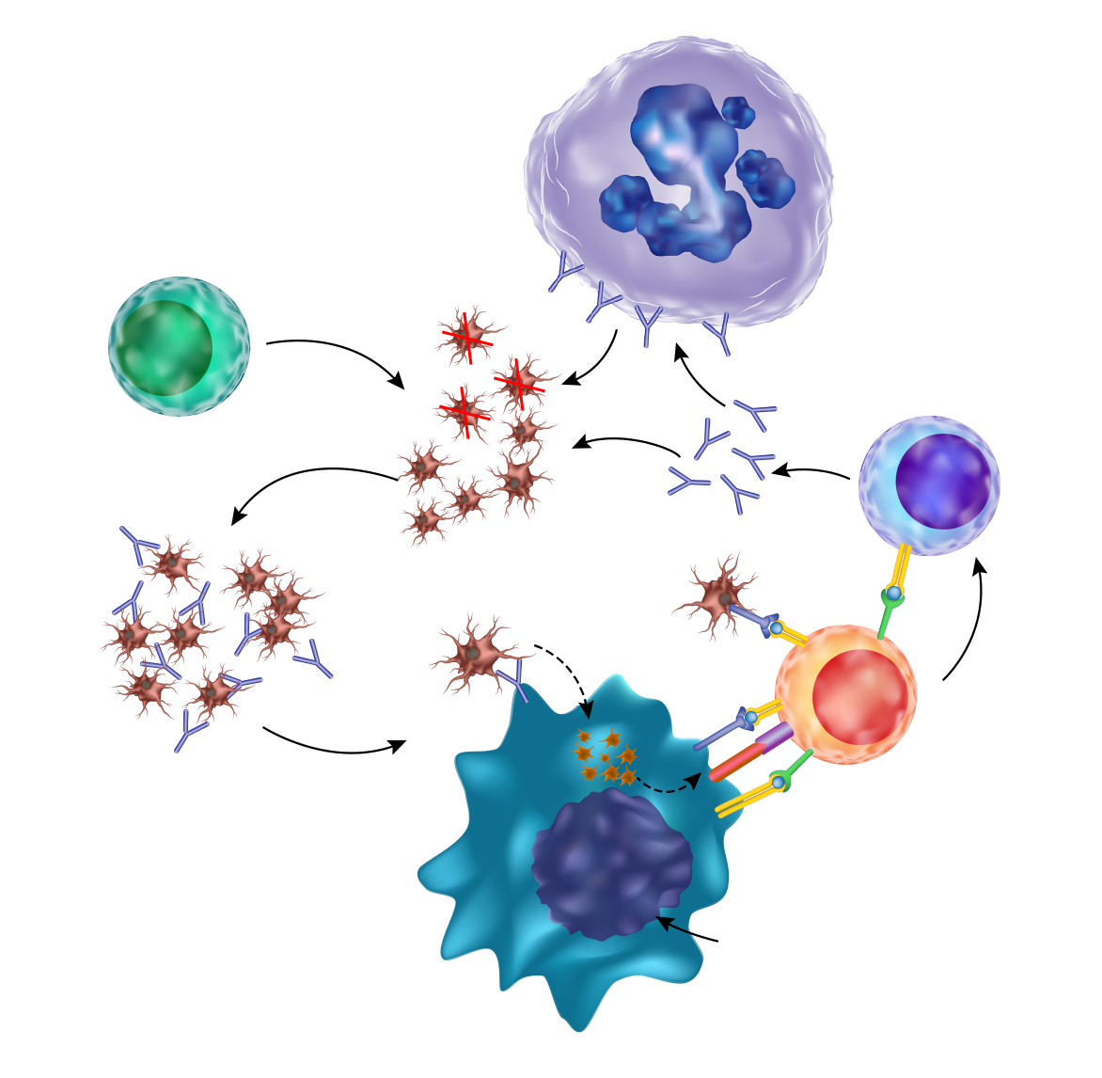
Pathophysiology of ITP
The pathogenesis of ITP involves^{1–5}
The production of antiplatelet antibodies by plasma cells
Autoantibody coating of platelets, resulting in:
  Autoantibody-mediated accelerated platelet clearance by removal via splenic macrophages and dendritic cells
  Complement deposition and platelet apoptosis
  Impaired megakaryopoiesis and thrombopoiesis
T-cell-mediated direct destruction of platelets by cytotoxic T cells
T helper cells that promote the production of antiplatelet antibodies by B cells
Mechanisms involved in autoimmune platelet destruction may differ among patients
Megakaryocyte
Impaired megakaryocyte maturation; reduced platelet production
Platelet
autoantibodies
Cytotoxic
T cell
T-cell-mediated
platelet destruction
Platelets
B cell
B cell activation
Th cell activation
Platelet
phagocytosis
Th cell
1. Audia S, et al. Autoimmun Rev. 2017;16:620-32.
2. Stasi R, et al. Thromb Haemost. 2008;99:4-13.
3. Nugent D, et al. Br J Haematol. 2009;146:585-96.
4. Swinkels M, et al. Front Immunol. 2018;9:880.
5. Lambert MP, Gernsheimer TB, Blood. 2017;129:2829-35.
IL-2
IFN-γ
Macrophage
Adapted with permission from Stasi R, et al. Thromb Haemost 2008;99:4-13

Slide 9
Risk factors for developing ITP
Factors associated with an increased risk of ITP¹
Genetic factors
Polymorphisms in genes encoding specific cytokines or chemokines Specific human leukocyte antigen class I or II alleles miRNA regulating immune components Polymorphisms in Fcγ receptors
Environmental factors
Infections by pathogens, such as HCV, HIV, Helicobacter pylori, cytomegalovirus (CMV), varicella zoster Drugs Transfusion-induced immunization against platelets Autoimmune diseases Lymphoproliferative disorders
1. Swinkels M, et al. Front Immunol. 2018;9:880

Slide 10
Classification of ITP by etiology
ITP may occur as an isolated disease (primary) or may be associated with a triggering event (secondary)¹
Primary ITP accounts for 80% of all ITP cases²
Form of ITP | Description
Primary ITP¹ | An autoimmune disorder characterized by isolated thrombocytopenia (peripheral blood platelet count < 100 × 10⁹/L) in the absence of other causes or disorders that may be associated with thrombocytopenia
Secondary ITP¹ | All forms of immune-mediated thrombocytopenia except primary ITP, including: Antiphospholipid syndrome Systemic lupus erythematosus (SLE) Hepatitis C virus (HCV) infection Drug-induced thrombocytopenia Helicobacter pylori infection Human immunodeficiency virus (HIV) infection
1. Rodeghiero F, et al. Blood. 2009;113:2386-93.
2. Swinkels M, et al. Front Immunol. 2018;9:880.

Slide 11
Classification of ITP by time from diagnosis, severity, and response to treatment
ITP is classified according to the (1) time from diagnosis, (2) severity of the disease, and (3) response to treatments
Form of ITP | Description
Newly diagnosed ITP | ≤ 3 months from diagnosis
Persistent ITP | 3–12 months from diagnosis, including: Patients not reaching spontaneous remission Patients failing to maintain complete response to therapy
Chronic ITP | > 12 months from diagnosis
Severe ITP | Bleeding symptoms at presentation sufficient to mandate treatment, or occurrence of new bleeding symptoms requiring additional therapeutic intervention with a different platelet-enhancing agent or an increased dose
Refractory ITP² | Patients who have failed splenectomy or relapsed thereafter, and have severe ITP or have a risk of bleeding that requires therapy Since in modern practice, splenectomy is only performed on a small minority, therefore refractory is often referred to patients who have failed multiple lines of therapy.
1. Neunert CE, et al. Blood. 2008;112:4003-8.
2. Neunert C, et al. Blood. 2011;117:4190-207.
3. Newton JL, et al. Eur J Haematol. 2011;86:420-9.
4. Kim KJ, et al. Br J Haematol. 2013;161:706-14.

Slide 12




Epidemiology of primary ITP
ITP is a rare disease
ITP incidence by age group^{4,5}
 | Region | Incidence (per 100,000)
Adults | Overall¹ | 3.3
 | Europe/global¹ | 1.6–3.9
 | USA² | 6.6
Children | Overall³ | 4.0
 | Europe/global¹ | 1.1–12.5
 | USA² | 5.0
ITP can occur at any age
A peak incidence is observed in:
Children aged 2–4 years
Young adults
The elderly > 65 years of age
ITP incidence by gender⁴
Among young adults, the incidence of ITP is higher in women than in men
Among teenagers and the elderly, the incidence is similar between the sexes
In the 2–5-year age group, the incidence is slightly higher in boys than in girls
1. Terrell DR, et al. Am J Hematol. 2010;85:174-80.
2. Izak M, Bussel JB. F1000Prime Rep. 2014;6:45.
3. Labarque V, Van Geet C. Eur J Pediatr. 2014;173:163-72.
4. Yong M, et al. Br J Haematol. 2010;149:855-64.
5. Kühne T, et al. J Pediatr. 2003;143:605-8.

Slide 13
Clinical presentation of ITP
  The physical signs and symptoms of ITP vary among patients
      Some patients suffer from major bleeding that requires immediate attention, while others present with few self-limited symptoms
  Intracranial hemorrhage (ICH) is the most serious complication of ITP¹
  Fatal bleeding occurs most commonly in adults with platelet counts < 30 × 10⁹/L²
Sign or symptom | Description
Bleeding² | Most common symptom of ITP Presents as mucocutaneous bleeding Purpura may appear on the extremities without any obvious precipitating event Nose bleeds, heavy menstruation, and gum and gastrointestinal bleeding
Fatigue³ | Often underappreciated Occurs in ~ 22–39% of adults and ~ 22% of children with ITP Correlates with platelet counts < 100 × 10⁹/L, steroid treatment, and bleeding Does not correlate with duration of ITP, age, or gender
Thrombosis⁴ | Patients with ITP are at increased risk of venous, arterial, or combined thromboembolic events Patients with increased antiphospholipid antibodies might be at higher risk
1. Neunert CE, et al. Blood. 2008;112:4003-8.
2. Neunert C, et al. Blood. 2011;117:4190-207.
3. Newton JL, et al. Eur J Haematol. 2011;86:420-9.
4. Kim KJ, et al. Br J Haematol. 2013;161:706-14.

Slide 14
Diagnosis of ITP
American Society of Hematology guidelines^{1,2} | Institute of Cancer Research guidelines^{2,3}
History and physical examination to identify cause of bleeding and exclude other causes of thrombocytopenia or secondary ITP: Antiphospholipid syndrome Autoimmune thrombocytopenia Common variable immune deficiency CMV, Helicobacter pylori, HCV, HIV, or varicella zoster infections, and SLE Lymphoproliferative disorders Side effects of vaccination, other drugs, or bone marrow transplantation | History, physical examination, complete blood count (CBC), and peripheral smear examination to exclude other etiology for thrombocytopenia: HIV, HCV, or other infections, and SLE Liver diseases, vaccination, alcohol abuse, or drugs Bone marrow diseases Post-transfusion purpura Inherited thrombocytopenia
CBC and peripheral smear to identify abnormalities other than thrombocytopenia and iron deficiency | CBC and peripheral smear to identify abnormalities other than thrombocytopenia and findings of anemia
Bone marrow examination is not necessary, regardless of age, in patients with typical ITP | Bone marrow examination (bone marrow aspirate and biopsy) may be informative in Patients aged > 60 years with systemic symptoms or abnormal signs Certain patients in whom splenectomy is considered
1. Neunert C, et al. Blood. 2011;117:4190-207.
2. Labarque V, Van Geet C. Eur J Pediatr. 2014;173:163-72.
3. Provan D, et al. Blood. 2010;115:168-86.

Slide 15
Evolution of ITP and prognosis
  ITP is associated with:¹
      A 1.5-fold higher mortality rate compared with the general population
      A significant increase in the risk of bleeding and infection, with a relative risk of 2.4 and 6.2, respectively
Parameter | Adult ITP | Pediatric ITP
Chronicity of disease | ITP is typically chronic in adult patients² | Chronic in only 20% of children³
Onset of ITP⁴ | Gradual | Acute
Spontaneous remission⁵ | 20–30% within 1 year | ~ 80% within 1 year
Preceding infection⁴ | Unusual | Common
Intra-Cranial Hemorrage and mortality | ICH occurs in 1.5% of adults with ITP⁶ 5% lifetime risk of fatality, mainly due to ICH² | ICH occurs in < 1% of children with ITP and is rare in persistent ITP^{5,7} 25% mortality due to ICH, especially in majority of patients with platelet counts < 10 × 10⁹/L⁸
1. Frederiksen H, Br J Haematol. 2014;166:260-7.
2. George JN, et al. Blood. 1996;88:3-40.
3. Labarque V, Van Geet C. Eur J Pediatr. 2014;173:163-72.
4. Stasi R, Provan D. Mayo Clin Proc. 2004;79:504-22.
5. Arnold DM. Hematology Am Soc Hematol Educ Program. 2015;2015:237-42.
6. Cines DB, Blanchette VS. N Engl J Med. 2002;346:995-1008.
7. Schulze H, Gaedicke G. Haematologica. 2011;96:1739-41.
8. Psaila B, et al. Blood. 2009;114:4777-83.

Slide 16
ITP impact on quality of life
  ITP may have a major impact on patients’ quality of life (QoL)
  I-WISh, a cross-sectional survey, evaluated QoL in patients with ITP and physicians’ perception of the impact of ITP on patients’ life¹
  Compared with patients, fewer physicians felt ITP would impact daily activities and social life; results for emotional well-being and work productivity were similar among physicians and patients¹
Parameter evaluated | Patients (%) (N = 1,491)
Reduced energy levels | 77
Limited ability to perform daily tasks | 75
Impaired social life | 70
Impact on emotional well-being | 49
Worry about condition worsening | 63
Negative effect on work productivity | 43
Missed work ≥ 6 hours | 24
Requiring care assistance | 52
1. Cooper N, et al. ASH Annual Meeting 2018: Abstract 4804

Slide 17

ITP treatment goals
The goal of treatment for adult and pediatric ITP patients is to achieve a platelet count that reduces the risk of major bleeding¹
  Rather than to “normalize” the platelet count
  It is recommended to maintain platelets above 30 x 10⁹/L
Treatment of patients with ITP should take into account the severity of the illness and the
age of the patient as these factors increase the risk of bleeding^{1,2}
1. Neunert C, et al. Blood. 2011;117:4190-207.
2. Rodeghiero F, et al. Blood. 2009;113:2386-93.

Slide 18
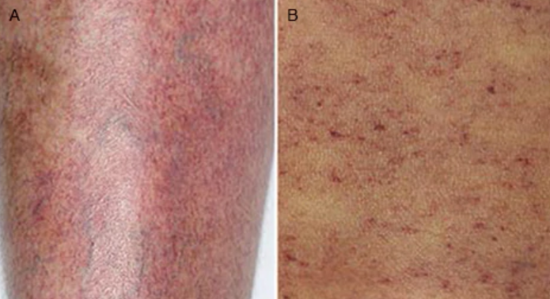
Initial management of ITP
American Society of Hematology recommendations: initial management of ITP¹
Adults
Initiate treatment when platelet count < 30 x 10⁹/L
Children
Children with no bleeding or mild bleeding (defined as skin manifestations only, e.g. bruising and petechiae) should be managed with observation alone, regardless of platelet count.
Treatment may be appropriate in the following cases:
  The patient presents with no/mild bleeding and follow-up is not assured
  There are concerns related to activity level or risk of bleeding
  There is a need due to upcoming procedure(s) associated with
  bleeding risk
Petechiae (puh-TEE-kee-ee): pinpoint, round spots that appear on the skin as a result of bleeding. The bleeding causes the petechiae to appear red, brown or purple.
(https://www.mayoclinic.org/symptoms/petechiae/basics/definition/sym-20050724).
1. Neunert C, et al. Blood. 2011;117:4190-207

Slide 19
Overview of Treatment Algorithm in Adult ITP
Treatment required:
Platelet count < 30 × 10⁹/L
Normal range of platelet: 150 – 450 x 10⁹ / L
Newly diagnosed
first-line
Corticosteroids
IVIg
Anti-D Ig
TPO-RAs
Rituximab
Splenectomy
Other therapies
Refractory
second-line
IVIg: Intro-Venous Immune Globulin
Anti-D Ig: anti Rho(D) immune globulin
Splenectomy: surgical resection of spleen responsible for producing antibody and for destruction of platelet.
Rituximab: believed to deplete CD20+ B cell which produces anti-platelet antibodies
1. Neunert C, et al. Blood. 2011;117:4190-207.
2. Provan D, et al. Blood. 2010;115:168-86.
3. Rituxan. Prescribing Information.
4. MabThera. Summary of product characteristics.
5. Neunert CE, Cooper N. Hematology Am Soc Hematol Educ Program. 2018:568-75.

Slide 20
Overview of Treatment Algorithm in Children With ITP
Watch and wait in patients
with no/mild bleeding,
irrespective of platelet count
Newly diagnosed
first-line
Corticosteroids (short course)
IVIg (single dose)
Anti-D Ig (specific patients only)
TPO-RAs
Rituximab
Splenectomy
Other therapies
Refractory
second-line
1. Neunert C, et al. Blood. 2011;117:4190-207.
2. Provan D, et al. Blood. 2010;115:168-86.
3. Rituxan. Prescribing Information.
4. MabThera. Summary of product characteristics.
5. Neunert CE, Cooper N. Hematology Am Soc Hematol Educ Program. 2018:568-75

Slide 21
Watch-and-Wait Strategy in First-Line
Definition
The watch-and-wait strategy consists of observation-only with regular platelet counts performed¹
Eligibility criteria
Watchful waiting may be appropriate in a restricted number of patients with asymptomatic/mild ITP at diagnosis¹
Age is associated with the occurrence of bleeding at diagnosis, thus this strategy is:²
  Recommended in children with no sign of bleeding
  Not recommended in adult patients with platelet counts ˂ 30 x 10⁹/L
  Not recommended in elderly patients who are at higher risk of bleeding
Rationale for the early treatment of patients with ITP
There is increasing evidence showing that early treatment is associated with a higher chance of response and long-term remission²
1. Neunert C, et al. Blood. 2011;117:4190-207.
2. Doobaree U, et al. Presented at EHA 2018; abstract E1430

Slide 22
Watch-and-Wait Strategy in First-Line
Recommended in:
Children with no bleeding
Adults with platelet counts > 30 x 10⁹/L
Not recommended in:
Adult patients with platelet counts < 30 x 10⁹/L
Elderly patients
PROS
CONS
Spontaneous remission in up to 10% of children per year
Children with no bleeding and adults with
> 30 x 10⁹/L could be free of treatment
Inexpensive
May lead to restricted health-related quality of life (QoL)
Risk of hemorrhage
Might generate anxiety in patients and caregivers
Not appropriate for elderly patients
One of the major predictive factors for response to treatment and remission is the early treatment of patients with ITP
1. Grainger JD, et al. Ann Hematol. 2010;89 Suppl 1:11-7.

Slide 23
Mechanism of Action of First-Line Therapeutic Options
Corticosteroids
Steroid hormones with immunosupressive properties. They supress T and B cell activation and prevent the production of antiplatelets antibodies and direct megakaryocyte killing by T cells.
Intravenous immunoglobulin (IVIg)
Pooled immunoglobulin G are derived from the plasma of human donors. The mode of action of IVIg is thought to saturate antibody receptors, leading to a decrease in autoantibody-coated platelet clearance.
Anti-D immunoglobulin (anti-D Ig)
Anti-D Ig are derived from the plasma of immunized Rhesus-negative human donors. It can only be used in Rhesus-positive non-splenectomized patients as the binding of anti-D Ig to the Rho(D) antigen on red blood cells, leads to its preferential destruction in the spleen and sparing autoantibody-coated platelets.
1. Zufferey A, et al. J Clin Med. 2017;6:16

Slide 24
Corticosteroids efficacy
Corticosteroids have been the standard of care for the first-line treatment of ITP for 3 decades
  Corticosteroids used for the treatment of ITP comprise prednisone, prednisolone, methylprednisolone, dexamethasone
The majority of patients initially respond to a short course of corticosteroids, but usually relapse when the drug is tapered and discontinued^{1,2}
  Leading to repeated courses of corticosteroids
Long-term use is associated with significant complications impacting patients’ QoL
  Adverse events (AEs) associated with corticosteroids are^{2–4}: weight gain, gastrointestinal (GI) distress, hyperglycemia, diabetes, hypertension, mood disorders, anxiety, insomnia, opportunistic infections, etc.
Long-term use of corticosteroids is also associated with high health care resource utilization^{3,5}
Treatment | Initial response | Sustained response at 12 months
Prednisone 1 mg/kg/day for 4 weeks and low dose for up to 12 months | 67.4% | 33%
Dexamethasone 40 mg/day, for 4 days every 2–4 weeks, for 1–4 cycles | 82.1% | 36.8%
1. Wei Y, et al. Blood. 2016;127:296-302.
2. Provan D, et al. Blood. 2010;115:168-86.
3. Rice JB, et al. Clin Ther. 2017;39:2216-29.
4. Tilden D, Value Health. 2015;18:A688.
5. Dalal AA, et al. J Manag Care Spec Pharm. 2016;22:833-47.

Slide 25
Corticosteroid safety profile
“ ”
With time, the detrimental effects of corticosteroids often outweigh their benefits.
Provan D et al., Blood 2010; 115:168186
14
13.0
Dexamethasone
12
Methylprednisolone
10
Prednisolone
8
Proportion of patients (%)
6
4.3
4.8
4
4.0
3.1
4.0
4.0
3.7
2
1.7
1.2
2.3
1.7
0
0.2
1.0
0
GI upset
Diabetes
Psychiatric symptoms
GI bleed
Hypertension
Thus, in patients not responding to a first course of corticosteroids, prolonged treatment should be avoided and second-line therapy should be considered²
1. Provan D, et al. Blood. 2010;115:168-86.
2. Cooper N, Tarantino MD. Oral presentation at ISTH 2009

Slide 26
Corticosteroid pro and con
Indicated in newly diagnosed:
  Adult patients
  Children as a short-course therapy if necessary
PROS
CONS
Most commonly used¹
Easily accessible¹
Effective²
Most patients relapse when the dose is reduced³
Tolerability decreases with time, leading to multiple AEs impacting on QoL²
1. Stasi R, Provan D. Mayo Clin Proc. 2004;79:504-22.
2. Provan D, et al. Blood. 2010;115:168-86.
3. Stevens W, et al. Neth J Med. 2006;64:356-63.

Slide 27
IVIg efficacy and safety in the first line
Dosing regimen^{1,2}
IVIg is administered at the hospital as an infusion over several hours to monitor potential injection-related AEs
Adults
  0.4 g/kg/day for 5 days; alternatively, 1 g/kg/day for 1 or 2 days has been shown to yield a higher response
Children
  Single dose of 0.8–1 g/kg
Efficacy^{3,4}
A rapid response is observed in ~ 80% in 1–4 days
Response only lasts 2–4 weeks
IVIg is not a viable continuous/long-term treatment. It is expensive, requires long hospital stays and induces only short-term responses. Thus, IVIg is mainly used to sustain platelet counts during acute thrombocytopenia phases
Safety profile⁵
Headache, chills, nausea, vomiting, anemia, tachycardia
Rarely, anaphylactoid reactions, thrombotic events
1. Neunert C, et al. Blood. 2011;117:4190-207.
2. Stasi R, Provan D. Mayo Clin Proc. 2004;79:504-22.
3. Provan D, et al. Blood. 2010;115:168-86.
4. Stevens W, et al. Neth J Med. 2006;64:356-63.
5. Ammam EM, et al. Am J Hematol. 2016;91:594-605

Slide 28
Anti-D Ig efficacy and safety in the first line
Dosing regimen^{1–3}
Anti-D Ig are administrated at the hospital as an infusion over several hours to avoid injection-related AEs. An observation period of at least 8 hours is necessary due to rare serious AEs
Anti-D Ig can only be used in non-splenectomized rhesus-positive patients
The recommended dosing in adults and children is 50–75 μg/kg
Efficacy^{1,2}
Response rates are similar to IVIg ~ 80% in 1–4 days
Response duration is similar to IVIg: only lasts 3–4 weeks
Anti-D Ig is not a viable continuous/long-term treatment. It is expensive, requires long hospital stays and induces short-term responses. Anti-D Ig are mainly used to sustain platelet counts during acute thrombocytopenia phases
Safety profile^{1,2}
Common: hemolytic anemia (dose-limiting toxicity) and fever/chills
Rare: intravascular hemolysis, multiorgan dysfunction, renal failure, and death
1. Lazarus AH, Crow AR. Transfus Apher Sci. 2003;28:249-55.
2. Provan D, et al. Blood. 2010;115:168-86.
3. Tarantino MD, et al. Blood. 2007;109:5527; author reply 5528.

Slide 29
First line intravenous globulins summary
IVIg and anti-D Ig use in patients with newly diagnosed ITP results in a rapid, short-term response in most patients
The mode of administration (infusions at the hospital), cost, potential AEs, and short response duration make immunoglobulins a therapy of choice to treat acute thrombocytopenia, but they are not viable in the long-term
PROS
CONS
Mild adverse effects (most of which can be minimized with slow infusion rates)¹
High response rates¹
Rapid response¹
Transient response (3–4 weeks)²
Risk of transmission of blood-borne pathogens³
High cost²
Anti-D Ig only effective in Rh(D)-positive, non-splenectomized patients
Anti-D Ig not licensed in Europe, not available in all countries
1. Provan D, et al. Blood. 2010;115:168-86.
2. Stasi R, Provan D. Mayo Clin Proc. 2004;79:504-22.
3. Gupta V, et al. Indian J Pediatr. 2008;75:723-8.

Slide 30
Mechanism of Action of Second-Line Therapeutic Options
Splenectomy¹
Splenectomy is a definitive approach that consists of the removal of the spleen to prevent platelet clearance by splenic macrophages.
Rituximab²
Rituximab is an antibody that targets CD20, a molecule expressed by most B cells, leading to B cell elimination. The mode of action of rituximab in ITP has not been clearly addressed, but may involve the elimination of antiplatelet antibody-producing B cells.
Trombopoietin receptor agonists (TPO-RAs)^{3,4}
TPO-RAs stimulate megakaryopoiesis and thrombopoiesis (platelet production) by binding to the TPO receptor (TPO-R) and can also promote immune tolerance by stimulating Treg (regulatory T cell) and Breg (regulatory B cell).
1. Provan D, et al. Blood. 2010;115:168-86.
2. Stasi R, Provan D. Mayo Clin Proc. 2004;79:504-22.
3. Gupta V, et al. Indian J Pediatr. 2008;75:723-8.

Slide 31
Splenectomy rate is decreasing
Efficacy^{1,2}
In a systematic review of 2,623 adult patients, complete responses to splenectomy were observed in 66% of patients (median follow-up of 29 months)²
Splenectomy is not recommended in frail
patients
Due to the emergence of novel medical therapies and concerns about long-term safety, rates of splenectomy have continuously decreased over the years^{1,2}
The panel recognizes that many patients and an increasing number of physicians prefer to delay or avoid splenectomy, such that the surgical rate has fallen in more recent cohorts.
“ ”
Rodeghiero et al., 2009 Blood
Decline in splenectomy with time¹
40
30
AEs³
Complication rate is 9.6%
Serious AE are venous thromboembolism and sepsis
Mortality rate is 0.2%
20
Rate of splenectomy (%)
10
0
1991
1994
1997
2000
2003
2006
2009
Year
1. Boyle S, et al. Blood. 2013;121:4782-90.
2. Kojouri K, et al. Blood. 2004;104:2623-34.
3. Mikhael J, et al. Am J Hematol. 2009;84:743-8.
4. Rodeghiero F, et al. Blood. 2009;113:2386-93.

Slide 32
Splenectomy pro and con
Splenectomy was considered the standard second-line therapy in adults with ITP who are refractory to first-line treatments¹
~ 66% of patients achieve a lasting response after splenectomy²
In most patients, splenectomy is deferred for ≥ 6 months,¹ but often for > 12 months² after diagnosis
PROS³
CONS³
Long-term remission in two-thirds of patients
Apparent low rate of late complications of splenectomy, especially following laparoscopic procedure
Risk of perioperative bleeding
Splenectomy prevents anti-D Ig administration
Irreversible (loss of a healthy organ)
Potential long-term serious AEs: pulmonary hypertension, thrombotic events, sepsis, and malignancies
1. Stasi R, et al. Thromb Haemost. 2008;99:4-13.
2. Provan D, et al. Blood. 2010;115:168-86.
3. Grainger JD, et al. Ann Hematol. 2010;89 Suppl 1:11-7

Slide 33
Rituximab efficacy and safety in second line
Dosing regimen
375 mg/m² weekly for 4 weeks (sometimes 100 mg/m² in children)
  However, variable doses are used in clinical practice
Efficacy
60% overall response and 40% partial response in adults
  Response rates in children are highly variable among studies
  Meta analysis of five trials (n=376 adult ITP) showed 57% overall response rate, 38% 1-year remission rate, 21% 5-year remission rate (Lancet Haematol 2015, 2(02):e75–e81).
Response is observed within a few weeks of injection
Response lasts a median of 11 months in responders
Safety profile
Usually mild-to-moderate first-infusion fever/chills, rash, or scratchiness in throat
More severe reactions include serum sickness
Very rarely, bronchospasm, anaphylaxis, pulmonary embolism, retinal artery thrombosis, infection, fulminant hepatitis via reactivation of hepatitis B, progressive multifocal leukoencephalopathy
Repeated courses of rituximab can lead to long-lasting immunosuppression and increase the risk of infections
1. Provan D, et al. Blood. 2010;115:168–86.
2. Arnold DM, et al. Ann Intern Med. 2007;146:25-33.
3. Auger S, et al. Br J Haematol. 2012;158:386-98.

Slide 34
Rituximab in phase III study
There is a lack of controlled clinical trials addressing the efficacy and safety of rituximab in ITP patients, and to support its off-label use in the second-line in ITP patients
A recent controlled phase 3 study (N = 112) addressed the efficacy of rituximab compared with placebo in patients with corticosteroid-refractory ITP. No significant difference was found in terms of cumulative incidence of response (81% vs 74%; p = 0.15) or reduction in the risk of treatment failure compared with placebo
In this controlled phase 3 study, rituximab did not significantly improve response and risk of bleeding compared with placebo
1. Ghanima W, et al. Lancet. 2015;385:1653-61.

Slide 35
Rituximab pro and con
PROS
CONS
Effective in the normalization of platelet counts in some patients
Dosing weekly for only 4 weeks
Ability to retreat responders who relapse
Not licensed for ITP
Lack of well-controlled clinical trials
New agents with better safety profiles should be preferred (ASH guidelines)
Lack of consensus on dosing/administration
High cost
Rate of durable responses to rituximab does not exceed 40%
Long-term toxicity not well defined in any population and especially not in children
Risk of long-lasting immunosuppression, serious infections, development of progressive multifocal leukoencephalopathy and activation of hepatitis B
Serum sickness in an unclear proportion of patients
1. Ghanima W, et al. Lancet. 2015;385:1653-61

Slide 36
Fostamatinib pro and con
What? Oral pro-drug of Syk (spleen tyrosine kinase) inhibitor (Tamatinib R406)
How? Syk is active in inflammatory cells including splenic macrophages, fostamatinib prevents the generation of autoantibodies by B cell and prevent the destruction of autoantibody-coated platelets by blocking their uptake by macrophages
When? Approved in 2018 in the USA as a second-line therapy for ITP
Evidence? In two double-blind randomized controlled trials of heavily pretreated patients with severe or refractory ITP and a median disease duration of 8.5 years, the overall response rate (one or more platelet counts ≥50 x10⁹/L over a 12-week period) was 43% in the fostamatinib arm vs. 14% in placebo arm; stable response rate (at least 4 of 6 biweekly platelet counts ≥50 x10⁹/L) was 18% in the fostamatinib arm and 2% in the placebo arm (Am J Hematol 2018;93(07):921–930).
PROS
CONS
Approved in the USA²
Increases platelet counts in 43% of patients (vs 14% with placebo)^{1,3–5}
Not licensed in Europe
Risk of hypertension⁶
Hepatic toxicity⁶
Lacking long-term efficacy and safety data
1. Bussel J, et al. Am J Hematol. 2018;93:921-30.
2. FDA approves fostamatinib tablets for ITP.
3. Podolanczuk A, et al. Blood. 2009;113:3154-60.
4. Bussel J, et al. Am J Hematol. 2018 ;93:921-30.
5. Bussel JB, et al. Am J Hematol. 2019;94:546-53.
6. Tavalisse. Prescribing information.

Slide 37
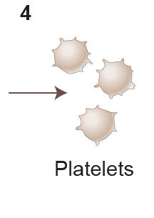
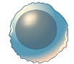
Thrombopoietin Receptor Agonist – TPO-RA
TPO-RA
Bone marrow
Megakaryocyte
Platelets
IST
TPO-RAs (Thrombopoietin Receptor Agonist) promote megakaryopoiesis and thrombopoiesis (platelet production) by binding to the TPO-R, without causing immunosupression^{1–3}
TPO-RAs may help recover the activity of regulatory T and B cells, thus improving autoimmune tolerance⁴
Autoantibodies
IST
CTL
B cell
IST
Antigen presenting cell
Treg
Breg
TPO-RA
1. Garzon AM, et al. Front Pediatr. 2015;3:70.
2. Promacta. Prescribing information.
3. Nplate . Prescribing Information.
4. Gómez-Almaguer D. Ther Adv Hematol. 2018;9:309-17.
Figure adapted from Gomez-Almaguer D, et al. Ther Adv Hematol. 2018;9:309-17.

Slide 38
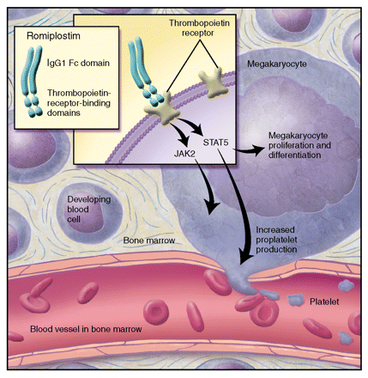
TPO-RA: Romiplostim
Indication
Romiplostim is approved by the US Food and Drug Administration (FDA) and the European Medicines Agency (EMA) for the treatment of patients ≥ 18 years
  With chronic ITP or ITP lasting 6 months or longer who had an inadequate response to first-line treatments or splenectomy^{1,2}
Mechanism of action
Engineered fusion of a novel TPO-R binding peptide with the Fc portion of IgG.¹ Binds to the TPO-R in a competitive manner with endogenous TPO
Attachment to the TPO-R triggers platelet production²
Mode of administration
Peptide that is not orally bioavailable
It is administered once weekly by subcutaneous injection
Figure from Perreault S, Burzynski J. Am J Health Syst Pharm. 2009;66:817-24.
1. Nplate. Prescribing information.
2. Nplate. Summary of product characteristics.
3. Perreault S, Burzynski J. Am J Health Syst Pharm. 2009;66:817-24.

Slide 39
TPO-RA: Romiplostim
Dosing regimen¹
Initial dose of 1 µg/kg weekly
Increased by increments of 1 μg/kg until the patient achieves a platelet count ≥ 50 × 10⁹/L
Platelet counts should be assessed weekly until a stable platelet count is reached
Maximum once-weekly dose of 10 μg/kg
Efficacy²
Following the first 4 weeks of study, romiplostim maintained platelet counts ≥ 50 × 10⁹/L in
50–70% of patients during the 6-month treatment period vs 0–7% of patient in the placebo group
Safety profile³
The most common AEs observed include hypersensitivity reactions (including cases of rash, urticaria, and angioedema), extremity pain, insomnia, myalgia, dizziness, abdominal pain, and headache
Serious AEs include bleeding upon cessation of treatment, increased bone marrow reticulin, thrombotic events, medication error (overdose and under dose have been reported), progression of existing myelodysplastic syndrome, and loss of response
Development of anti-romiplostim antibodies due to the protein nature of the drug, leading to a loss of response, is a recognized AE, but its frequency has not been established
1. Nplate. Prescribing information.
2. Nplate. Summary of product characteristics.
3. Kuter D, et al. Lancet. 2008;371:395-403..

Slide 40
Romiplostim Efficacy and Safety: Pivotal Studies Design
The safety and efficacy of romiplostim was evaluated in 2 placebo-controlled, double-blind studies
Romiplostim
1 µg/kg subcutaneous weekly
(dose adjusted to maintain platelet count between 50 and 200 x 10⁹/L)
Study 1: n = 41
Study 2: n = 42
Study 1 (N = 62)
Non-splenectomized patients
2:1 Randomization
Study 2 (N = 63)
Splenectomized patients
Placebo
Study 1: n = 21
Study 2: n = 21
24 weeks
1. Nplate. Summary of product characteristics.

Slide 41
Romiplostim Efficacy and Safety: Pivotal Studies Results
Key point: A significantly higher proportion of romiplostim-treated patients achieved durable and overall platelet responses vs placebo
Outcome | Study 1 Non-splenectomized patients |  | Study 2 Splenectomized patients
 | Romiplostim (n = 41) | Placebo (n = 21) | Romiplostim (n = 42) | Placebo (n = 21)
Durable platelet response, n (%) | 25 (61)* | 1 (5) | 16 (38)† | 0 (0)
Overall platelet response, n (%) | 36 (88)* | 3 (14) | 33 (79)* | 0 (0)
Number of weeks with platelet count ≥ 50 x 10⁹/L, mean | 15* | 1 | 12* | 0
Required rescue therapy, n (%) | 8 (20)‡ | 13 (62) | 11 (26)§ | 12 (57)
Durable platelet response with stable dose, n (%) | 21 (51)‡ | 0 (0) | 13 (31)∥ | 0 (0)
p values for romiplostim vs placebo: *p < 0.0001. †p = 0.0013, ‡p = 0.001, §p = 0.0175, ∥p = 0.0046.
1. Nplate. Summary of product characteristics.

Slide 42
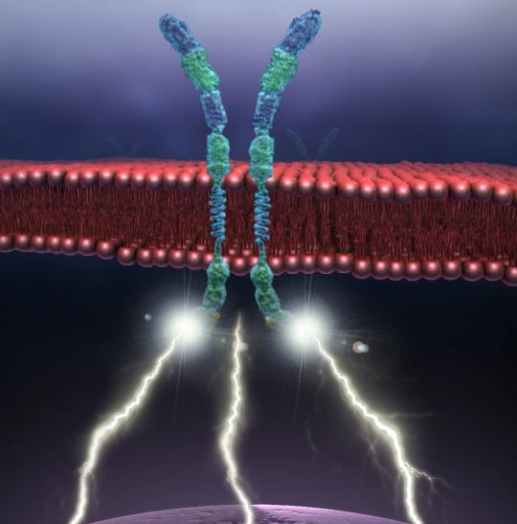




TPO-RAs: Eltrombopag
Indication
Eltrombopag is approved by the FDA and EMA for the treatment of patients with chronic ITP or ITP lasting 6 months or longer who had an inadequate response to first-line treatments or splenectomy^{1,2}
Mechanism of action
Interacts with the transmembrane domain of the TPO-R, initiates signaling cascades, and induces proliferation and differentiation of bone marrow progenitor cells, stimulating megakaryopoiesis and platelet production³
Mode of administration
Eltrombopag is an orally administered, non-peptide small-molecule TPO-RA⁴
Administered once daily as oral tablets or prepared
as an oral suspension with water^{1,2}
TPO-R
Eltrombopag & transmembrane domain
JAK2 kinase
STAT
RAS/RAF
MEK
MAPK/ERK
1. Promacta. Prescribing Information
2. Revolade. Summary of product characteristics.
3. Erickson-Miller CL, et al. Stem Cells. 2009;27:424-30.
4. Jenkins JM, et al. Blood. 2007;109:4739-41.
See specific module for full details on eltrombopag
efficacy and safety profile in ITP

Slide 43
Comparison among TPO-RA
 | Romiplostim | Eltrombopag | Avatrombopag
Molecular structure | peptide | Small molecule | Small molecule
TPO receptor site of action | Extracellular domain | Transmembrane domain | Transmembrane domain
Route of administration | Subcutaneous | Oral | Oral
Dosing frequency | Weekly | Daily | Daily
Relevant food interactions | NA | Yes | No
Average US wholesale price | $2,230.30 per 250 μg vial $4,460.59 per 500 μg vial | $197.06 per tablet (12.5mg or 25 mg) $356.61 per tablet (50 mg) $534.92 per tablet (75 mg) | $356.40 per 20 mg tablet
Current indications | Chronic ITP (adults and children) | Chronic ITP (adults and children) Hepatitis C–associated thrombocytopenia Severe aplastic anemia | Periprocedural thrombocytopenia in chronic liver disease patients Chronic ITP (adults)
Patients with significant TPO elevations (>200 pg/ml) were unlikely to respond well to either eltrombopag or romiplostim, whereas patients with a normal TPO level (≤ 100 pg/ml) were very likely to respond (Am J Hematol 2018, 93(12): 1501-1508). Given the cost and time to titrate these agents to clinical effect, if validated, the use of TPO level to predict treatment response may emerge as a valuable tool in treatment planning.
Failure of 1 TPO-RA does not preclude the use of another; switching from one TPO-RA to another is successful in many patients (Int J Hematol 2015;101(03):255–263).
Hanny Al-Samkari & David J. Kuter, Semin Thromb Hemost 2019, pmid.31830764

Slide 44
Comparison of 2nd line ITP treatment options
 | Splenectomy | TPO-RA | Rituximab
Early response rate | 85% | 70-80% | 50-60%
Sustained response rate | 60-70% | 70-80% while on treatment | 20% off treatment
Remission rate | 60-70% | 30-40% | 20%
Financial burden | Low | High | Moderate
Positive clinical aspects | Offers long-term remission in majority of patients; No need for chronic treatment; avoid medication side effects | Well tolerated with high response rate; multiple therapeutic options; avoid surgery | No need for chronic treatment; usually well tolerated; avoid surgery
Potential major or important adverse events | Operative complications; immediate and life-time increased risk of thromboembolism (especially splanchnic vein thrombosis) and infection; life-time increased of malignancy | Headache, hepatotoxicity (eltrombopag only), venous thromboembolism (theoretical risk), bone marrow fibrosis (low risk, reversible) | Infusion reaction, B cell depletion and infections, progressive multifocal leukoencephalopathy (rare), delayed neutropenia (rare)
Qualify of life issues | None after initial post-surgical period | Chronic dietary restrictions (eltrombopag), weekly injection (romiplostim) | None
Hanny Al-Samkari & David J. Kuter, Semin Thromb Hemost 2019, pmid.31830764

